Slide 1
How to Avoid Double Dipping Financial Aid Funds, Waivers, and Research Grants
Jessica Ly Florida International University
Notes:
Hello and welcome to the financial aid information session. We will be discussing important information in regards to financial aid here at FIU.

Slide 2
An over-award exist when a student’s aid package exceeds his or her need or overall cost of attendance.
COA minus EFC minus EFA equals need
Over-awards become overpayments if a school cannot correct the over-award before the funds disburse to a student.
Our goal is to clear over-awards before they become over-payments
What is an over-award
Notes:
In order to apply for financial aid, students must complete their FAFSA application to determine their eligibility. Students need to apply online at www.fafsa.gov. Please keep in mind that FIU has a priority deadline of March first of every year.

Slide 3
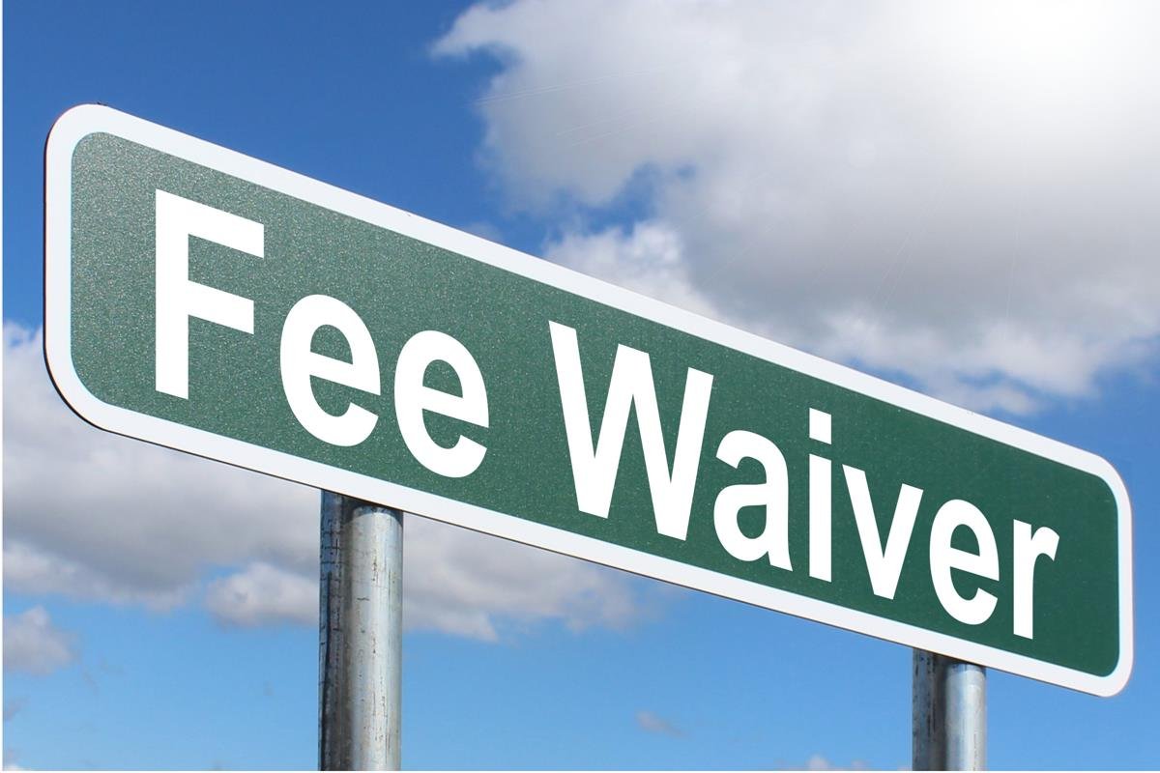
What is a Waiver?
Tuition is a component of the cost of attendance, tuition waivers are counted as estimated financial assistance to determine a student’s financial need for grants, loans, and work study.
FIU students receiving tuition waivers are charged tuition and fees that are credited with a waiver item type on the Student Financials module.
Waivers count towards the total “aid” a student receives
When adding a waiver to student’s award package you must clear the over-award
Notes:
In order to apply for financial aid, students must complete their FAFSA application to determine their eligibility. Students need to apply online at www.fafsa.gov. Please keep in mind that FIU has a priority deadline of March first of every year.

Slide 4
Waiver Projections
Graduate Waiver Projections
to reduce the number of students who are over-award, we assign waiver projections
All prior term waiver recipients are assigned a waiver projection for the upcoming term
Graduate waivers are projected based on enrollment
Miscellaneous Waiver Projections
All other waivers are categorized as miscellaneous waivers
All prior term waiver recipients are assigned a waiver projection for the upcoming term
Misc. waivers are projected based on the type of waiver and enrollment
Notes:
In order to apply for financial aid, students must complete their FAFSA application to determine their eligibility. Students need to apply online at www.fafsa.gov. Please keep in mind that FIU has a priority deadline of March first of every year.

Slide 5
Waiver Descriptions

Slide 6
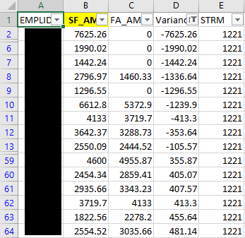
The Waiver Process
Waiver query scheduled to run and send to cgfinaid@fiu.edu email
Query checks whether there is a variance between the Student Financials and the Financial Aid module
Waivers are actualized daily, and over-awards are cleared
Notes:
In order to apply for financial aid, students must complete their FAFSA application to determine their eligibility. Students need to apply online at www.fafsa.gov. Please keep in mind that FIU has a priority deadline of March first of every year.

Slide 7
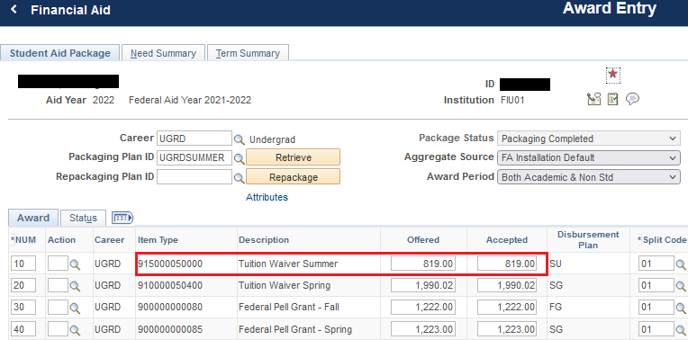
Financial Aid Module
Notes:
In order to apply for financial aid, students must complete their FAFSA application to determine their eligibility. Students need to apply online at www.fafsa.gov. Please keep in mind that FIU has a priority deadline of March first of every year.

Slide 8
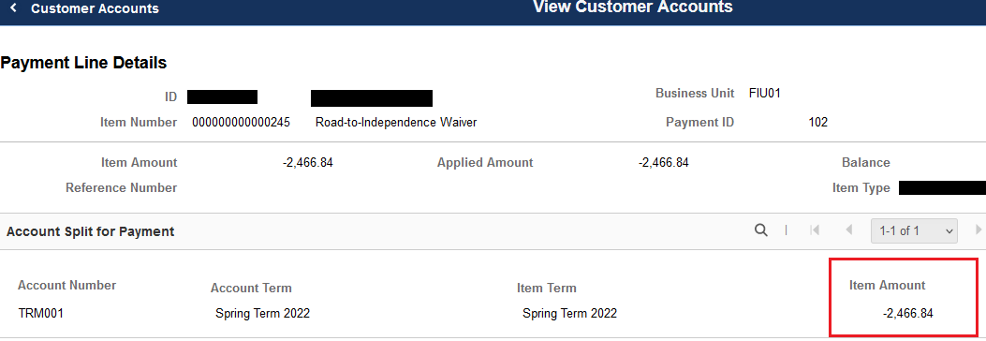
Student Financials Module

Slide 9
Steps: Awarding Waivers
Step 1
Adjust waiver discrepancy
Step 2
Clear over-awards
Step 3
If unable to clear over awards, place a no refund hold
Step 4
Holds should be released within 2 business days
Notes:
In order to apply for financial aid, students must complete their FAFSA application to determine their eligibility. Students need to apply online at www.fafsa.gov. Please keep in mind that FIU has a priority deadline of March first of every year.

Slide 10
Contracts/Grants
Contracts and Grants are state, federal, and institutional funds typically awarded to graduate and PhD students doing research. Some grants are awarded to undergraduates who are enrolled in a special program.
Grants are generally used to pay tuition, tuition and fees, scholarships, or stipends.
Contracts and grants count towards the total “aid” a student is eligible to receive
You must clear any over-awards
Notes:
In order to apply for financial aid, students must complete their FAFSA application to determine their eligibility. Students need to apply online at www.fafsa.gov. Please keep in mind that FIU has a priority deadline of March first of every year.

Slide 11
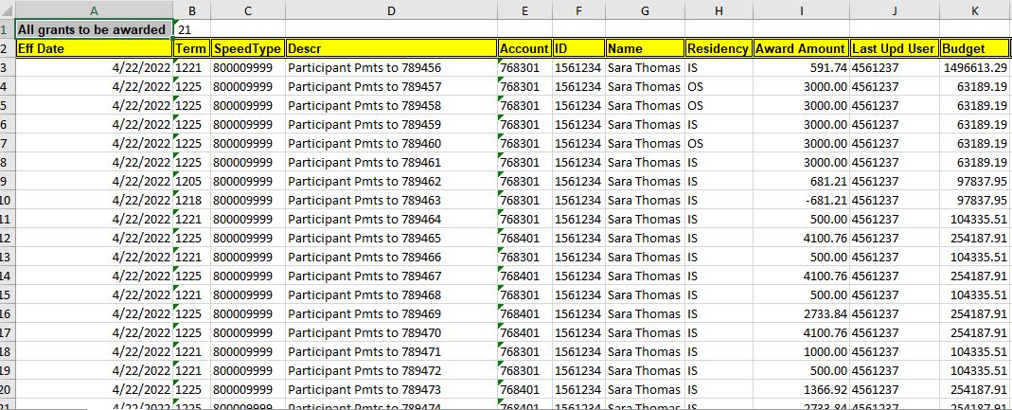
How Do We Process Grants
Grant payments are entered by departments
Payments are queried and scheduled to be sent to cgfinaid email
Entries are transferred to a master log
Notes:
In order to apply for financial aid, students must complete their FAFSA application to determine their eligibility. Students need to apply online at www.fafsa.gov. Please keep in mind that FIU has a priority deadline of March first of every year.

Slide 12
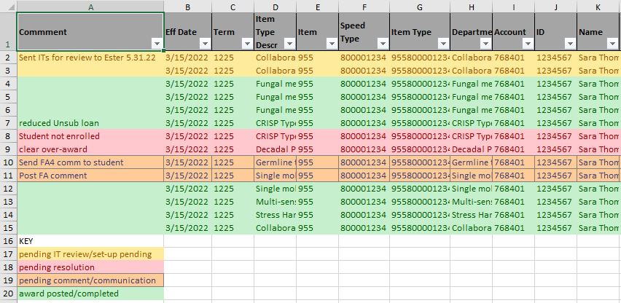
How Do We Process Grants
Grant payments are set-up in the system (Item Types in PeopleSoft)
Award students, clear over-awards, post comments, send student communications

Slide 13
Disbursements
Meet with your team and decide on disbursement dates
Keep in mind refund dates and timing of bank transactions
Will stipends disburse at the end, middle, beginning of the month
When possible, keep all stipend disbursements the same
Create a calendar and run reports to check grant disbursements
Notes:
In order to apply for financial aid, students must complete their FAFSA application to determine their eligibility. Students need to apply online at www.fafsa.gov. Please keep in mind that FIU has a priority deadline of March first of every year.

Slide 14
Considerations
Does your office consider cost of attendance increases?
Do you post grant payments for non-degree seeking students?
Does your office require student enrollment?
This Photo by Unknown Author is licensed under CC BY-NC
Notes:
In order to apply for financial aid, students must complete their FAFSA application to determine their eligibility. Students need to apply online at www.fafsa.gov. Please keep in mind that FIU has a priority deadline of March first of every year.

Slide 15
Cost of Attendance Increases
You are allowed to do a COA increase if a student is working and receiving a stipend as compensation
You must document it
At FIU, we require grant language to show grant payments can be used to compensate student for working
Letter of agreement between student and department
Name, date, signed
Work activities
Supervisor name, hours worked per week, compensation
Notes:
In order to apply for financial aid, students must complete their FAFSA application to determine their eligibility. Students need to apply online at www.fafsa.gov. Please keep in mind that FIU has a priority deadline of March first of every year.

Slide 16
Sample letter

Slide 17
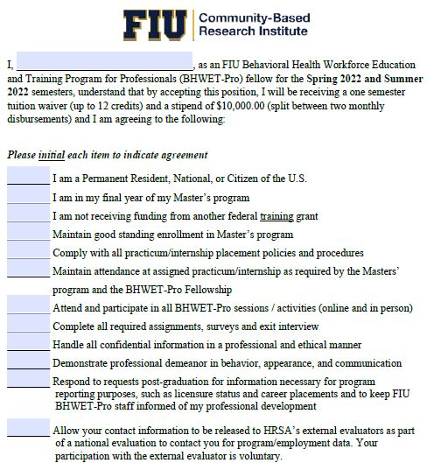
Sample letter

Slide 18
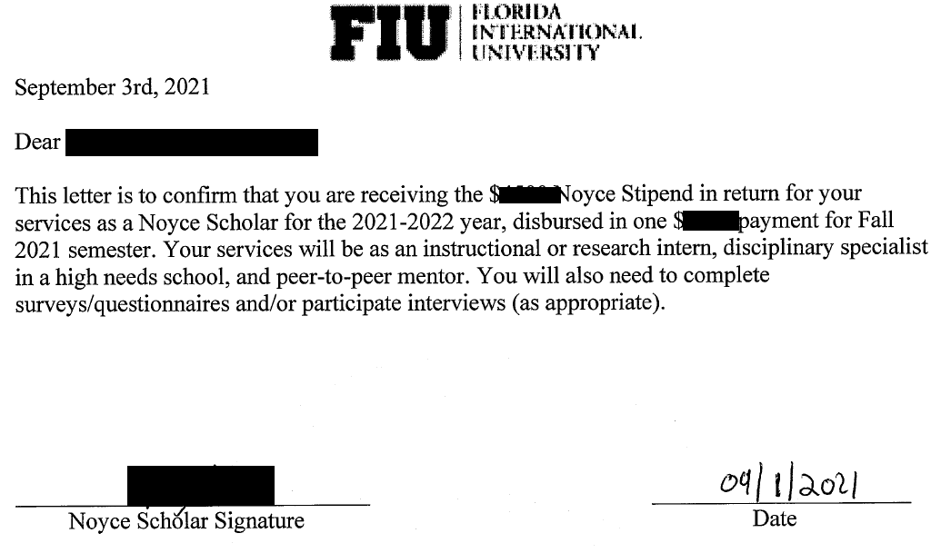
Sample letter

Slide 19
Best Practices
If you’re reversing a payment, place holds on the account to protect from being assessed fees
Master Log, use key colors to identify different scenarios
Have your master log on a shared drive
Set deadlines and communicate those deadlines to departments
Document cost of attendance increases
Build policies and procedures
Process all students using the same methodology
Build calendars, and organize your data on excel when possible
Set-up monthly outlook reminders
Notes:
In order to apply for financial aid, students must complete their FAFSA application to determine their eligibility. Students need to apply online at www.fafsa.gov. Please keep in mind that FIU has a priority deadline of March first of every year.

Slide 20
Thank You
Notes:
Hello and welcome to the financial aid information session. We will be discussing important information in regards to financial aid here at FIU.

